Slide 1
SAN FRANCISCO CITY EMPLOYEE SALARY DATA OVER 4 YEARS
Analysed by Group 4 members
Data Source: https://www.kaggle.com/kaggle/sf-salaries

Slide 2
One way to understand how a city government works is by looking at who it employs and how its employees are compensated. This data contains the names, job title, and compensation for San Francisco city employees on an annual basis from 2011 to 2014.

Slide 3
Possible Questions On Our Minds Before Data Exploration
What are the highest and lowest paid job titles?
Which Job titles have the most employee in San Francisco?
What is the average base pay and benefits per job title?
Did the base pay, benefits increase or decrease between 2011 – 2014?
Which job titles come with benefits ?
Which Job titles do not come with benefits?

Slide 4
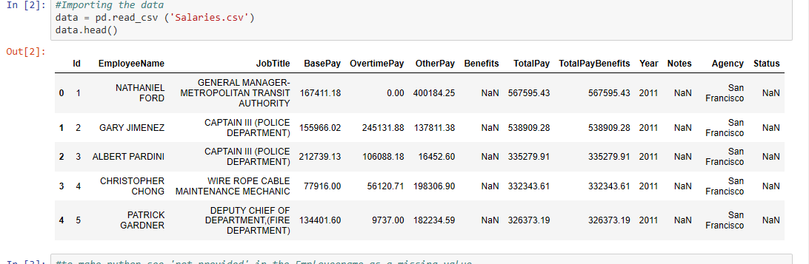
Data Overview

Slide 5
Data Cleaning
The 'not provided' in the Employee name column was declared a missing value because there was no payment assigned to it
The empty spaces in benefits, base pay, overtime pay and other pay columns was filled with zero, so python does not see them as missing values
'Notes', 'Status', 'Agency‘ were dropped since they were not needed
All missing values(NaN) were dropped

Slide 6
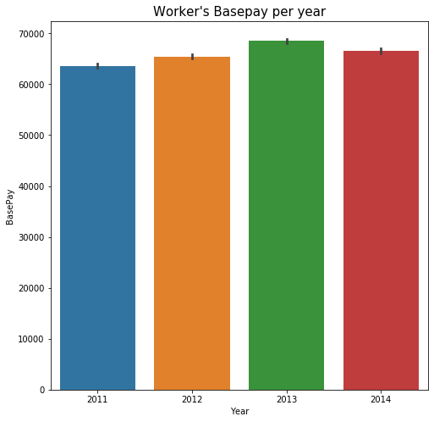
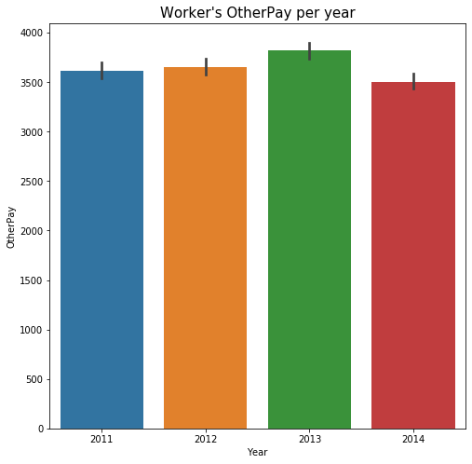
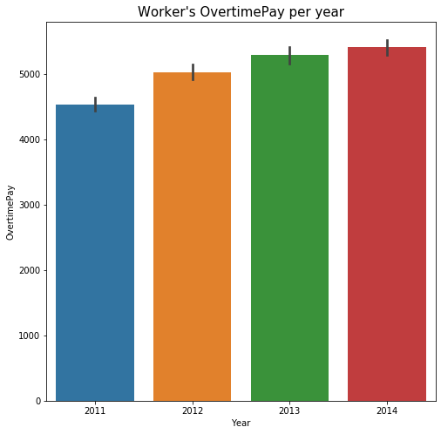
Bar chart showing employees Base pay, OvertimePay and OtherPay per year

Slide 7
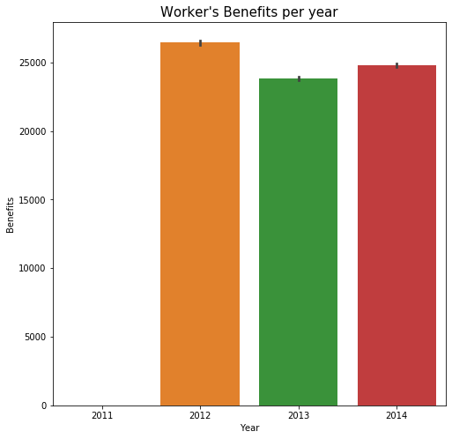
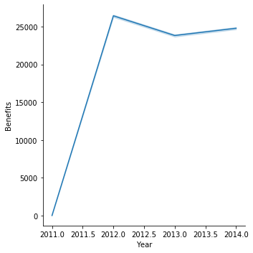
Line and Bar charts of Worker’s benefits per year

Slide 8
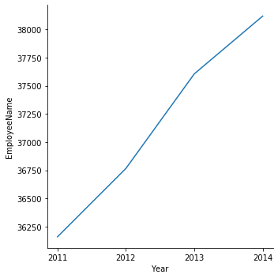
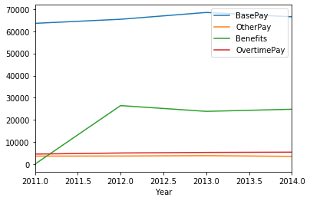
Line chart showing Base pay, Benefits, Other pay and Overtime pay per year
Line chart showing number of employees per year

Slide 9
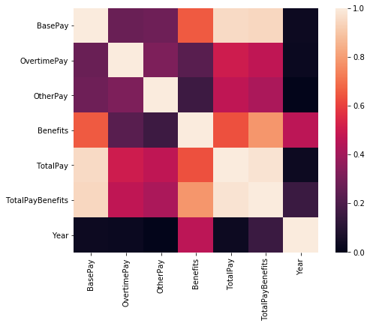
Heat Map showing the level of correlation between Base pay, Benefits, Other pay and Overtime pay

Slide 10
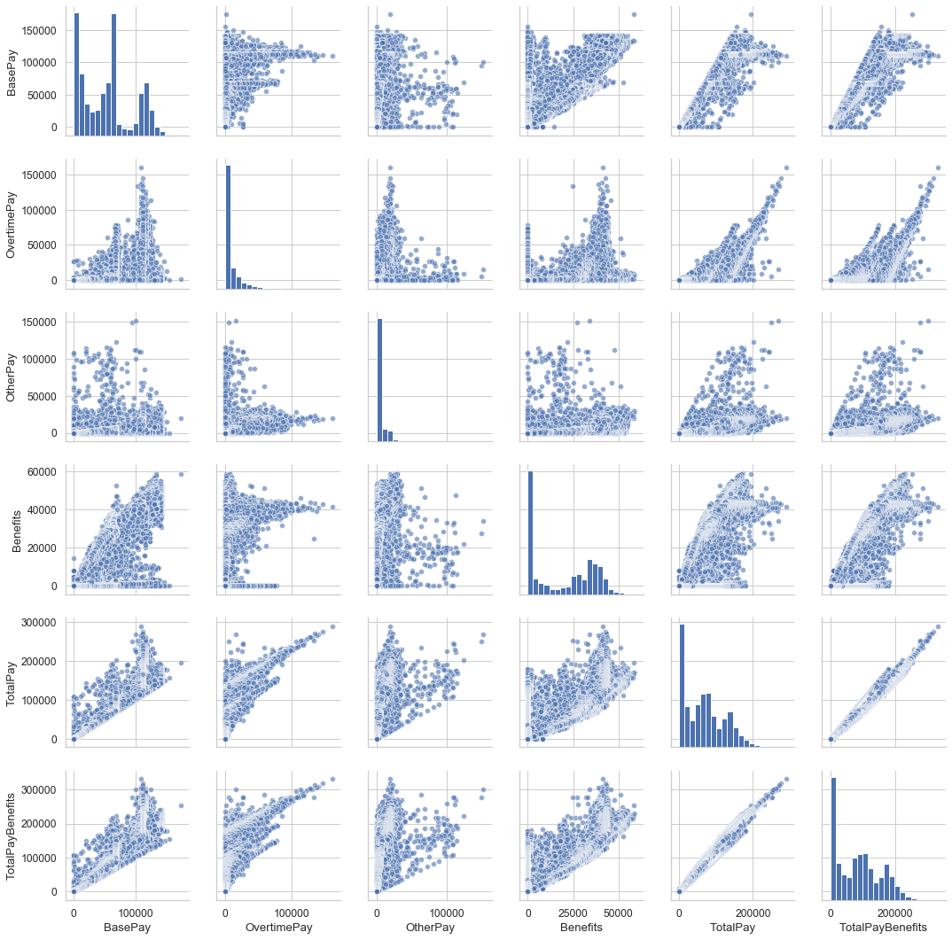

Slide 11
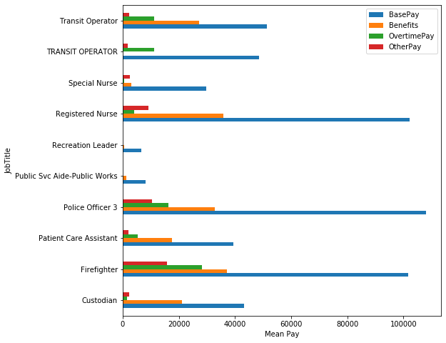
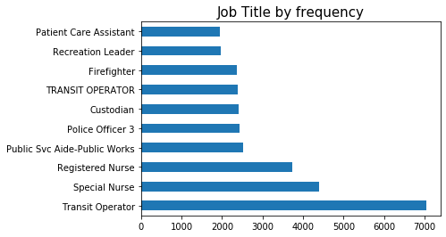

Slide 12
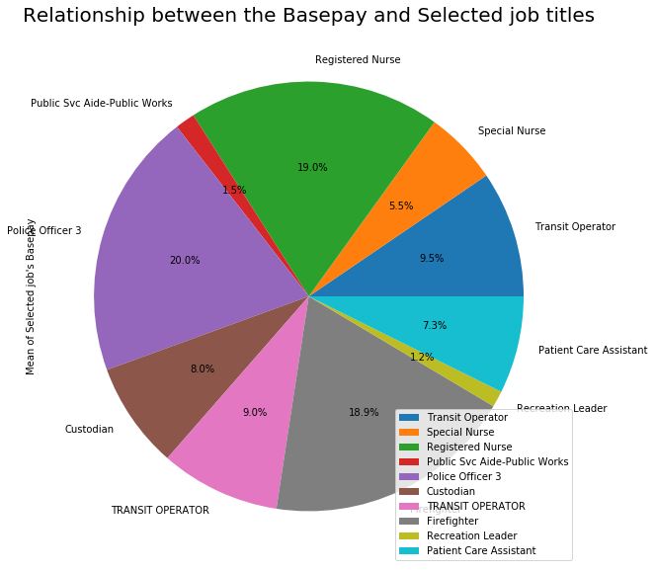
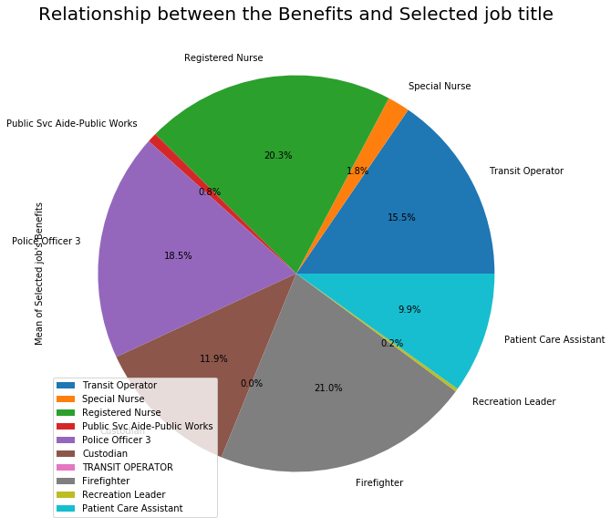

Slide 13
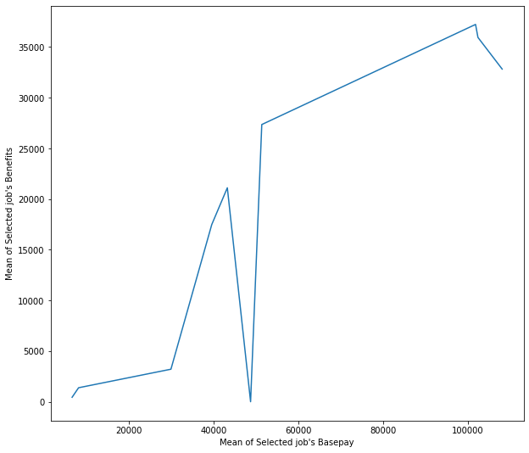
Relationship between the Selected job's Basepay and the benefits

Slide 14
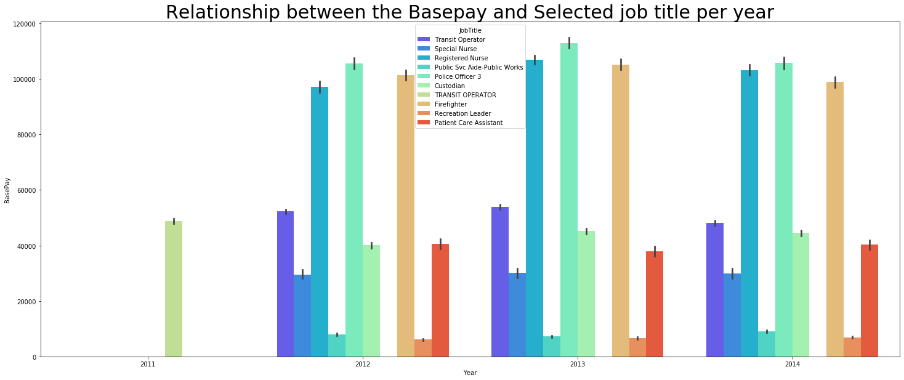

Slide 15
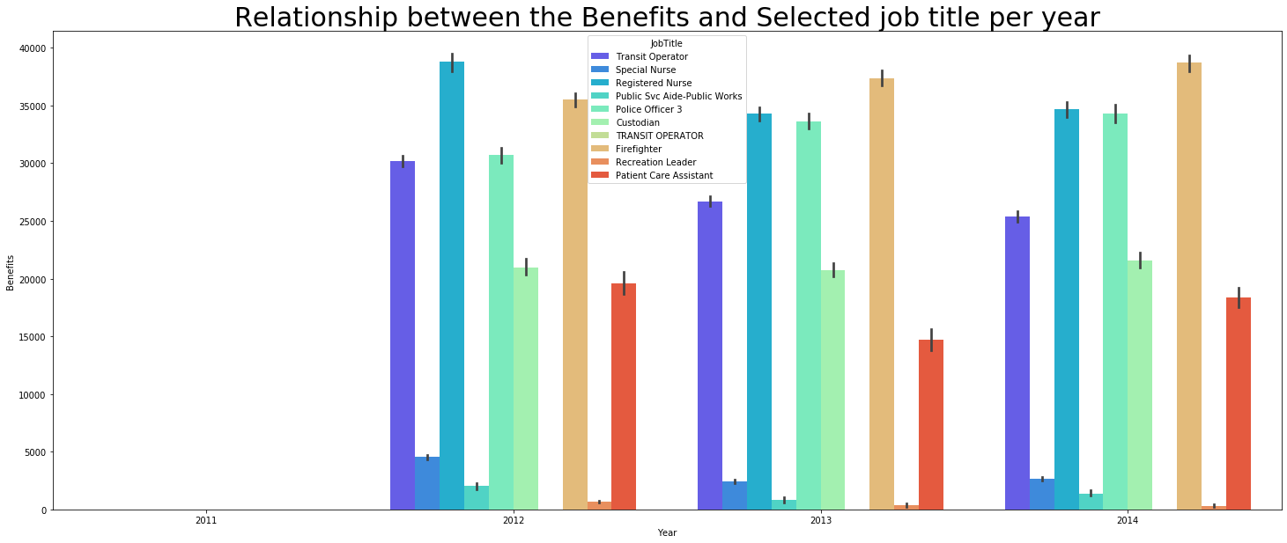

Slide 16
Conclusion
Employees were paid the lowest in 2011.
Employees were paid the highest in 2013.
No benefits was paid in 2011.
Police officers had the highest base pay,
Recreational leaders had the lowest basepay.
There were two Transit Operators , where we considered one to be contract staffs who worked only in 2011, without benefits

